Slide 1
SUPPORTING PEDAGOGICAL LEADERSHIP IN ELCC’S
A partnership between Mount Royal University & ARCQE
Notes:
Copyright by ARCQE

Slide 2
How will support with exploration of the curriculum framework unfold?
The Alberta Resource Centre for Quality Enhancement (ARCQE) & Mount Royal University (MRU) are pleased to be working with newly announced Early Learning and Child Care (ELCC) programs across Alberta!
Together we look forward to guiding Pedagogical Partner support & exploration of curriculum framework principles & practice in individual sites.
Notes:
About the Project:
As part of the new ELCC centre initiative, all sites will work with a pedagogical partner to support staff in learning and applying key concepts foundational to the Alberta Early Learning and Child Care Curriculum Framework.
Through a joint partnership between ARCQE & MRU, we are pleased to introduce the people known as pedagogical partners who will work with you and your educators to support learning about the curriculum framework in practice.
Who are Pedagogical partners?
Pedagogical Partners are early childhood educators from across Alberta who bring vast knowledge and expertise to ELCC’s, many of whom- having worked directly with and had experience facilitating implementation strategies with the framework over a 4 year research period.
The role of pedagogical partners is new and unique to current professional development models in Alberta, therefore partners will be teamed up with a Pedagogical Leader provided by members of the Mount Royal University research team.
As such partners working with ELCC’s throughout the project will receive extensive professional learning and resources to guide and provide a host of ideas and strategies on how to support educators understanding of the framework and put these concepts into practice in meaningful ways.

Slide 3
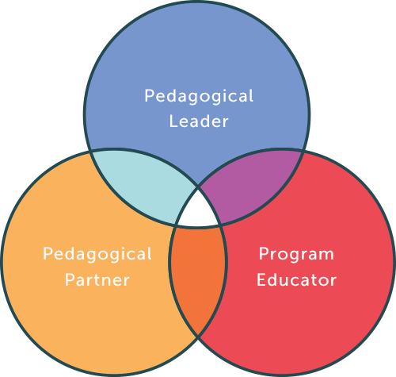
Pedagogical triad of support
While all members of the learning triad do not interact regularly together, all are integral to the process of support & engagement.
Notes:
Defining the Triad of Support…
The first layer of support is that of Pedagogical Leader with Mount Royal University
As significant support to the pedagogical triad, the MRU team has extensively researched supports and processes to facilitate learning about the curriculum framework in practice and have worked with 45 programs across southern Alberta forthe last four years.
Prior work with numerous programs provided a valuable opportunity to explore the supports needed for programs to begin implementing aspects of the curriculum framework in their practice in meaningful ways.
Subject to this, Mount Royal will be guiding leadership as part of the Pedagogical Support Triad to Partners who will then work alongside ELCC Centers to facilitate implementation of Framework concepts.
While the MRU team will not work with programs directly they will work collaboratively with ARCQE Pedagogical Partners who will be assigned to your program in leading the curriculum framework engagement onsite.
Pedagogical Partner (ARCQE)
The second layer of pedagogical support to this project, are partners who have been selected from across the child care community to work exclusively with your program.
Your partner will support the staff in learning and applying concepts in practice.
They work alongside the administrator and educators, supporting and learning about the curriculum framework; discovering how to make and bring these important ideas in a meaningful way in your program.
Initially, they will support course takers, and get to know the staff and children.
As your team moves forward in their learning, partners will continue to work with administrators and staff, model and engage in conversation about the framework, answering questions, and facilitate learning activities to increase understanding of this important work.
Pedagogical partners will then be providing individualized support and guidance in the form of monthly onsite visits where they will work with the program leaders to determine how to meaningfully implement relevant aspects of the curriculum framework.
And finally the Program Educators (ELCC Staff Members)
To support success, and build meaningful pedagogical relationships with educators, many elements of engagement & participation are extremely important.
One priority is in ensuring that either the program administrator or a lead educator can be available to meet with the pedagogical partner when they are on site for monthly visits.
Other meaningful ways educators can engage with this process is by way of enlisting additional educators from their sites in taking the online course together, and supporting their participation with pedagogical partners during onsite visits.
Reflective practice enables educators to actively engage and share ideas, so supporting collaborative learning opportunities will also be important to this process.

Slide 4
Process of Engagement
As the Pedagogical Partner roles evolve, the following are some of the ways they may be formally engaged with your centre:
Process of Engagement: Pedagogical Partners register and attend the MacEwan online curriculum course alongside ELCC members to support and create dialogue relative to weekly reflective writing activities, contributing to class postings and sharing reflections in on-line collaborative sessions.
Supporting & Strengthening Practice: In conjunction to taking the course together, Pedagogical Partners will also visit programs on a monthly basis for approximately 4 hours per month of coaching time to facilitate applying theoretical concepts of the course into daily practice.
Establishing Communities of Practice: Pedagogical Partners will also as appropriate coordinate Community of Learning (COL’s) sessions within ELCC sites as a means of engaging all centre educators on topic relative to overarching curriculum concepts.
Regional Learning Community Sessions: A significant part of the support process also places emphasis on connecting and bringing the professional community together The learning community model places focus on guiding and facilitating groups of 4-6 sites that come together as a regional learning community.
Notes:
So let’s talk about the Process of Engagement
Pedagogical Partners will certainly be a Resource…
Members of the Pedagogical Partner team bring a wide array of skills and expertise to supporting ELCC programs in the work relating to implementation of the framework.
Some of the resources they will bring to your program will be:
Offering time to listen, observe and understand the needs of your children, your educators, your families and your program. Together, you will determine the way into the curriculum.
Lending support by way of strong facilitation skills, and experience in supporting reflective practice dialogue and strategies with educators.
They will share enriched practice experience relative to educator-child engagement and co-constructed learning, responsive environments, and how to support relationship-based practice with children and families.
They will also facilitate in-depth understanding of practice relating to coaching, observation and documentation, facilitating effective communication, supporting authentic practice relating to cultural diversity.
No doubt you can count on your pedagogical partner to provide meaningful insight, guidance and support along your learning journey!

